Slide 1
Schedule K-1
Pub 4012 – Tab D
Pub 4491 – Lesson 13
Notes:
The entire Schedule K-1 slide deck is considered a comprehensive tax topic
Schedule K-1 is rarely seen at most AARP Tax-Aide sites
Instructors should choose those slides necessary to prompt discussion depending on the experience level of their volunteers
Instructors may choose to not present this material to new volunteers
This slide set can also be a good review resource for those certifying through self-study

Slide 2
Lesson Topics
Schedule K-1
Form K-1 types
Scope limitations
TaxSlayer entry

Slide 3
Schedule K-1
Schedule K-1 reports taxpayer’s share of
Income
Other distributions
Deductions
Credits

Slide 4
Schedule K-1
Pub 4012 Tab D
Four different Schedule K-1 forms
Form 1041 Estates and Trusts
Form 1065 Domestic partnerships
Form 1120S S Corporations
Form 8865 Foreign partnerships out of scope
Notes:
Direct volunteers to open Pub 4012 to Tab D K-1 section

Slide 5
Intake and Interview
Look for Schedule K-1 entry in Intake Booklet
Verify in scope before beginning return
Notes:
Carefully review any K-1s to make sure they are in scope.
Nothing is more discouraging to the taxpayer than having them go through the intake process and wait to have their return prepared only to be told that their return is out of scope.

Slide 6
Schedule K-1
Scope Manual
In-scope Schedule K-1s contain only
Interest income (taxable and tax-exempt)
Dividends (ordinary, qualified, and 199A)
Capital gains or losses (long or short)
Royalty income
Foreign tax paid for passive activities
All other Schedule K-1 entries out-of-scope
Notes:
Instructors should direct volunteers to review the Tax-Aide Scope Manual for Schedule K-1
Have a copy of the Scope Manual available on all classroom computers

Slide 7
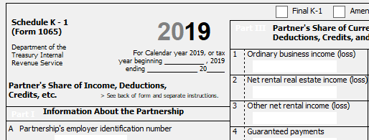
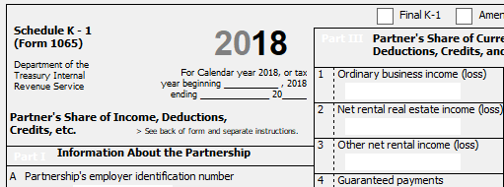
Schedule K-1
Verify year: May be 2018 form when entity on fiscal (not calendar) year
Notes:
Watch dates - could be fiscal year rather than calendar year K-1
2018 Schedule K-1 belongs on 2018 tax return

Slide 8
Schedule K-1
All forms found on irs.gov
All codes on back of form
Watch for additional statements
Statements may explain box entries

Slide 9
Schedule K-1 (Form 1065)
Negative end of year capital account
Return is out of scope
Notes:
A zero capital account could indicate that the partnership has terminated
If so, refer taxpayer to a professional preparer

Slide 10
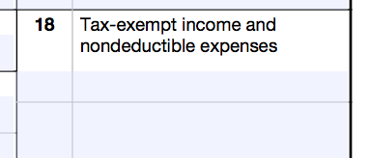
Schedule K-1 Interest Income
Exempt interest income
Box number varies by form
Code descriptions on back of form

Slide 11
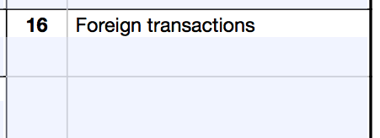
Foreign Tax paid on Schedule K-1
Box number varies by form
Must be coded Passive income
See Foreign Tax Credit lesson
Notes:
Emphasize
Only the simplified method for foreign tax credits is in scope (Foreign tax paid is NOT more than $300/$600 MFJ), unless two tax preparers at the site have International certifications.
Look on p.2 of K-1 (or back) for explanation of codes
For IRS copies look at irs.gov:
Form 1041 (Schedule K-1)Beneficiary's Share of Income, Deductions, Credits, etc.
Form 1065 (Schedule K-1)Partner's Share of Income, Deductions, Credits, etc.
Form 1120-S (Schedule K-1)Shareholder's Share of Income, Deductions, Credits, etc.

Slide 12
Entering K-1s in TaxSlayer
Pub 4012 Tab D
Schedule K-1 scope found in Pub 4012
Enter Schedule K-1 in TaxSlayer search box to retrieve correct form
Estates and Trusts (Form 1041)
Domestic Partnerships (Form 1065)
S Corporations (Form 1120S)
Notes:
Be careful to choose the right form. The taxpayer’s Schedule K-1 may come from a Form 1065 (partnership), Form 1120S (S-corp) or Form 1041 (estate).

Slide 13
Entering Schedule K-1s in TaxSlayer
Pub 4012 Tab D
Most in-scope Schedule K-1s are
Passive entity and
All investment at risk
Check appropriate boxes in TaxSlayer
Notes:
Most in-scope K-1s will be from a Passive Entity, and the taxpayer’s investment will be at risk. Be sure to check these boxes if applicable –TaxSlayer® may give you a warning if the At-Risk box is left blank.

Slide 14
Quality Review
Verify in scope
Verify tax year
Verify entries

Slide 15
Schedule K-1
Questions?
Comments ...

